Slide 1
Random String Solution
Using
GENETIC ALGORITHM
Presented By,
Anirban Routh Sayan Das Biswarup Roy
Department of Computer Science, A.C. College

Slide 2
Highlight
What is Genetic Algorithm and how does it work?
What’s the need of GA?
Pros & Cons of GA
Benefits of GA
Application of Genetic algorithm
Implementation

Slide 3
Genetic Algorithm
GA is a set of instructions that is repeated to solve a problem
Abstraction of Real Biological Evolution
Uses concepts of “Natural Selection” and Genetic Inheritance” (Darwin 1859)
Solve complex problems (like NP Hard)
Focus on optimization
Survival of the fittest

Slide 4
Pros & Cons of Genetic Algorithm
Pros
Does not require any derivative information (which may not be available for many real-world problems).
Is faster and more efficient as compared to the traditional methods.
Has very good parallel capabilities.
Optimizes both continuous and discrete functions and also multi-objective problems.
Provides a list of “good” solutions and not just a single solution.
Always gets an answer to the problem, which gets better over the time.
Useful when the search space is very large and there are a large number of parameters involved.
Cons
GAs are not suited for all problems, especially problems which are simple and for which derivative information is available.
Fitness value is calculated repeatedly which might be computationally expensive for some problems.
Being stochastic, there are no guarantees on the optimality or the quality of the solution.
If not implemented properly, the GA may not converge to the optimal solution.

Slide 5
Benefits of GA
Concept is easy to understand
Modular,separate from application
Supports multi-objective optimization
Always an answer ,answer gets better with time
Easy to exploit previous or alternate solutions
Flexible building blocks for hybrid applications

Slide 6
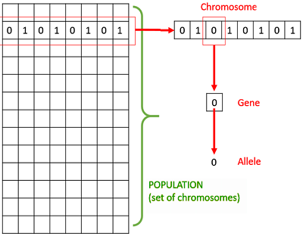
Basic Terminology
Population
Chromosome
Gene
Allele
Fitness Function
Genetic Operator

Slide 7
Generalized Pseudo-code for a GA
GA ( )
Initialize population
Find fitness of population
While (termination criteria is reached) do
Parent section
Crossover with probability pc
Mutation with probability pm
Decode and fitness calculation
Survivor selection
Find best
Return best

Slide 8
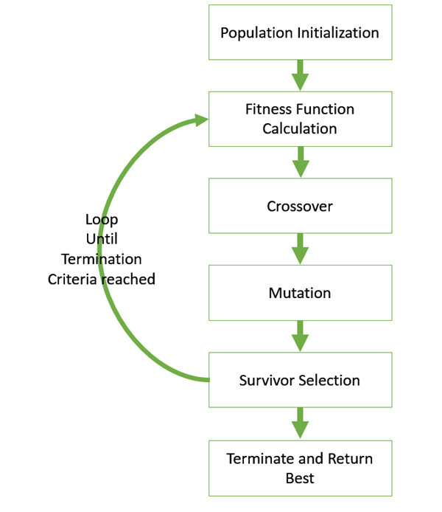
The GA Cycle of reproduction

Slide 9
Population Initialization
Population Initialization is the first step in GA. Population is the subset of solutions in the current situation. There are two primary methods to initialize a population in GA.
They are:
Random Initialization:Populate the initial population with completely random solutions.
Heuristic Initialization: Populate the initial population using a known heuristic for the problem.

Slide 10
Fitness Function Calculation
The fitness function simply defined is a function which takes a candidate solution to the problem as input and produces as output how “fit” or how “good” solution is with respect to the problem in consideration.
Calculation of fitness value is done repeatedly in GA and therefore it should be sufficiently fast.
A fitness function should possess the following characteristics:
The Fitness function should be sufficiently fast to compute,
It must quantitatively measure how fit a given solution is or how fit individuals can be produced from the given solution.

Slide 11
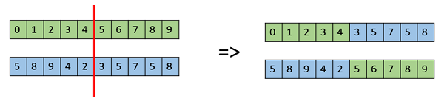
Crossover
Crossover is a genetic operation used to vary the programming of a chromosome or chromosomes from one generation to the next.
There are few different crossover operators used. They are:
One point crossover:
In this one-point crossover, a random
Crossover point is selected and the tails
of its two parents are swamped to get
new offsprings.

Slide 12
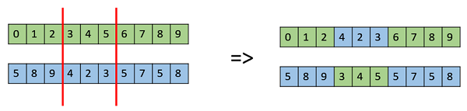
Crossover
2. Multi point Crossover.
Multipoint crossover is a generalization of the one point Crossover where in alternating segments are swamped to get new offsprings.

Slide 13
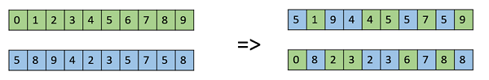
Crossover
3. Uniform Crossover
In a uniform crossover, we don't divide the chromosomes into segments, rather we treat each gene separately.

Slide 14
Mutation
It is used to maintain and introduce diversity in the genetic population and is usually applied with a low probability. Mutation is the part of the GA which is related to “exploration” of the search space. There are some mutation operator mentioned below:
Bit Flip Mutation:
In this biy flip mutation, we select one of mode random bits and flip then. This is used for binary encoding in GAs.

Slide 15
Mutation
2. Swap Mutation:
In Swap mutation,we select two positions on the chromosome at random,and interchange the values. This is common in permutation based encodings.
3.Inverse Mutation
In inverse mutation, we select a subject of genes like in scramble mutation, but instead of shuffling the subse, merrily invert the entire string in the subset.

Slide 16
Survivor Selection
The Survivor Selection policy determines which individuals are to be removed and which are to be kept in the next generation. Bellow are some selection methods:
Age Based Solution:
In age based selection, we don’t have a notion of a fitness. It is based on the premise that each individual is allowed in the population for a finite generation where it is allowed to reproduce, after that, it is removed from the population no matter how good its fitness is.
Fitness Based Selection:
In this fitness based selection, the children tend to replace the least fit individuals in the population. The selection of the least fit individuals may be done using a variation of any of the selection policies described before - tournament selection, fitness proportionate selection,etc.

Slide 17
Termination and Return Best
The termination condition of a Genetic Algorithm is important in determining when a GA run will end. It has been observed that initially, the GA progresses very fast with better solutions coming in every few iterations, but this tends to saturate in the later stages where the improvements are very small. We usually want a termination condition such that our solution is close to the optimal, at the end of the run.
Usually, we keep one of the following termination conditions:
When there has been no improvement in the population for X iterations.
When we reach an absolute number of generations.
When the objective function value has reached a certain pre-defined value.

Slide 18
Use Cases
Domain
Medicine
Software Development
Transportation
Robotics
Finances
Games
Cyber Security
Application Type
DNA Analysis
Machine Learning (GA based Machine Learning)
Vehicle Routing Problems
Robot Trajectory Generation
Economics
Poker, Checker, Tetris
Encryption & Decryption

Slide 19
Code:
//To begin the solution we first need to generate a random string which then can be gradually mutated to form the desired string of //the user.
//Code to generate Random String:
private static Random random = new Random();
private static String randomString(final String allowedCharacters, final int length)
{
return IntStream.generate(allowedCharacters::length).limit(length)
.map(random::nextInt).mapToObj(allowedCharacters::charAt)
.map(Object::toString).collect(Collectors.joining());
}
For the code visit https://github.com/Ani3002/Hello_World_GA

Slide 20
//Fitness Function
//Generating Fitness Function of the chromosomes:
private static int fitness(final String testedString, final String perfectString)
{
return IntStream.range(0, min(testedString.length(), perfectString.length()))
.map(index -> abs(testedString.charAt(index) - perfectString.charAt(index))).sum();
}
//This code is to output fitness value of each individual chromosome from each mutated population:
private static int fitness(final String testedString, final String perfectString)
{
return IntStream.range(0, min(testedString.length(), perfectString.length()))
.map(index -> abs(testedString.charAt(index) - perfectString.charAt(index))).sum();
}
private static void outputGeneration(final List<String> generation, final String perfectString)
{
generation .stream().sorted(Comparator.comparingInt(string -> fitness(string, perfectString)))
.peek(string -> System.out.format("%s - ", string))
.map(string -> fitness(string, perfectString))
.forEach(System.out::println);
System.out.println("----- ----- ----- ----- ----- ----- ----- -----");
}
For the code visit https://github.com/Ani3002/Hello_World_GA

Slide 21
//Survivor Selection
//Fitness Population Selection is one of the most common way of parent selection, so here we remove all
//the chromosomes that doesn’t match the required fitness function value.
private static List<String> unleashPredators
(
final List<String> generation,
final String perfectString,
final int survivors
)
{
return generation.stream().sorted(Comparator.comparingInt(string -> fitness(string, perfectString)))
.limit(survivors).collect(Collectors.toList());
}
For the code visit https://github.com/Ani3002/Hello_World_GA

Slide 22
//Crossover
//We create new chromosomes, which share roughly equal amounts of both parents (chromosomes) Gene.
private static String breed(final String mom, final String dad)
{
return IntStream.range(0, min(mom.length(), dad.length()))
.mapToObj(index -> random.nextBoolean() ? mom.charAt(index) : dad.charAt(index))
.map(Object::toString).collect(Collectors.joining());
}
For the code visit https://github.com/Ani3002/Hello_World_GA

Slide 23
//Mutation
//We will select new chromosomes to mutate again completely randomly:
private static List<String> repopulate(final List<String> generation, final int offspring)
{
return Stream.generate(() -> breed(generation.get(random.nextInt(generation.size())),
generation.get(random.nextInt(generation.size())))).limit(offspring).collect(Collectors.toList());
}
private static String mutate(final String individual)
{
final int mutationLocation = random.nextInt(individual.length());
final char newChar = (char) (individual.charAt(mutationLocation) + (random.nextBoolean() ? 1 : -1));
final StringBuilder builder = new StringBuilder(individual);
builder.setCharAt(mutationLocation, newChar);
return builder.toString();
}
private static List<String> mutateGeneration(final List<String> generation,final double mutationChanc
{
return generation.stream()
.map(individual -> random.nextDouble() < mutationChance ?
mutate(individual) : individual)
.collect(Collectors.toList());
}
For the code visit https://github.com/Ani3002/Hello_World_GA

Slide 24
//Termination
//To determine when the Genetic Algorithm run will end there must be a defined termination condition. The termination condition may be set to generate a certain number of generations or to terminate after a
desired fitness value is achieved or it also can be a combination of both.
private static final String PERFECT_STRING = "Hello World";
private static final int GENERATION_SIZE = 40;
private static final int SURVIVOR_SIZE = 10;
private static final int GENERATION_COUNT = 1000;
For the code visit https://github.com/Ani3002/Hello_World_GA

Slide 25
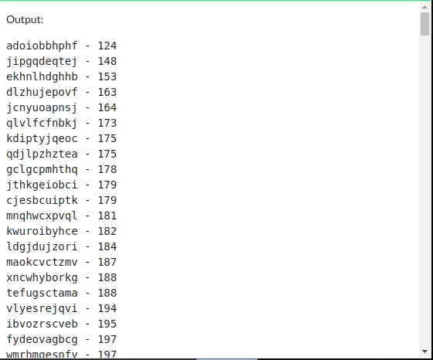
Output:

Slide 26
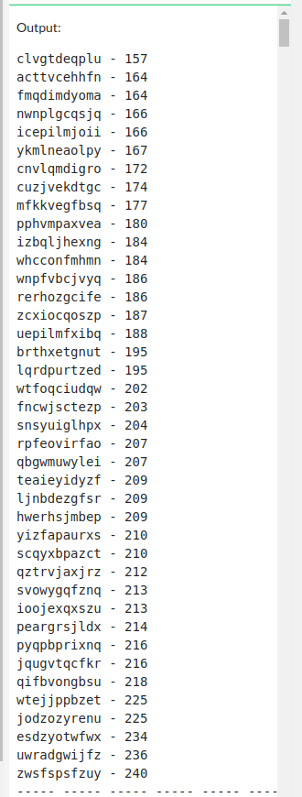
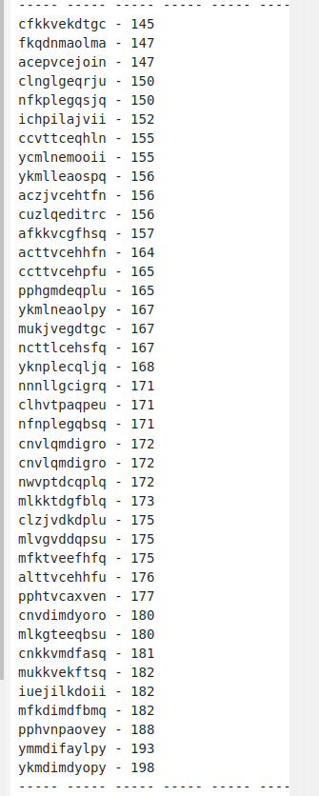
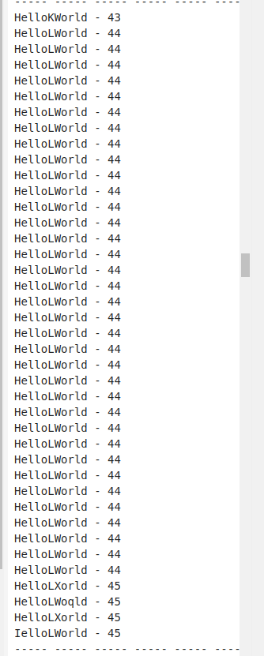
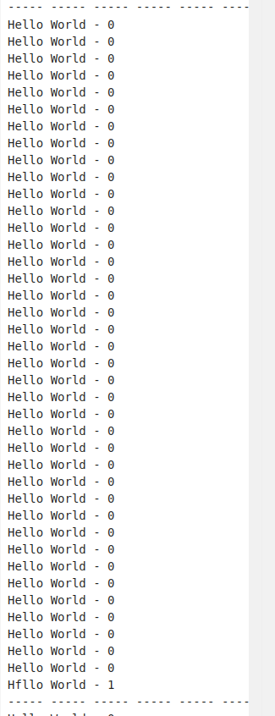
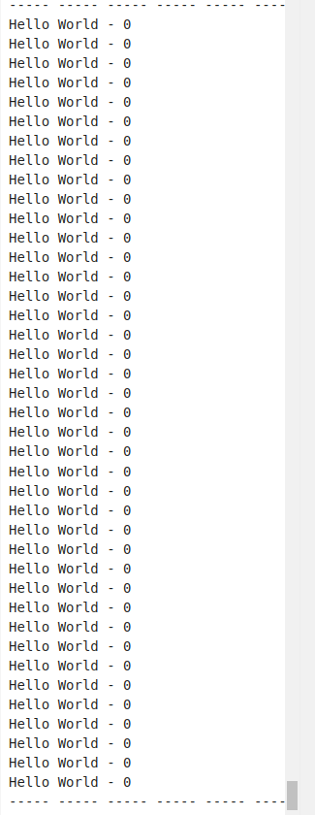
1st 2nd mid 2nd last last

Slide 27
Looking at the last two generations we see the fitness function reduces from 1 to 0. More less the number the greater the fitness function is. 0 is the highest fitness value.

Slide 28
The End
Presented By,
Anirban Routh Sayan Das Biswarup Roy
Department of Computer Science, A.C. College

